Slide 1

Notes:
----- Meeting Notes (6/25/13 12:05) -----

Slide 2
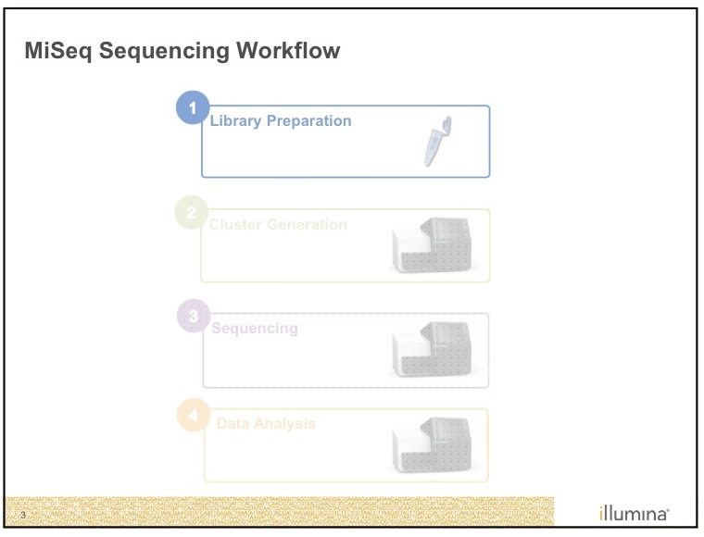

Slide 3
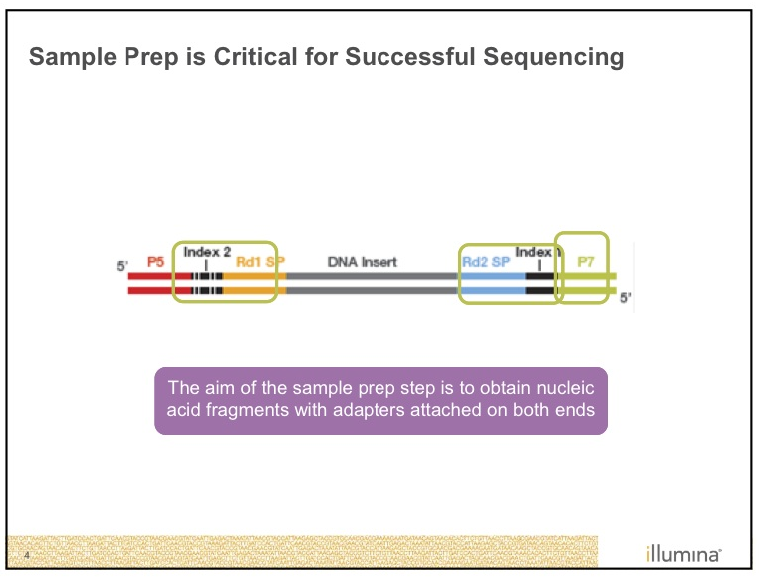
Notes:
Prepare your DNA or RNA as usual. For RNA it is recommended that you further clear out rRNA (preferred kit by epicentre followed by minelute kit by qiagen). Quantitate with Qubit. Can do nanodrop for ratios or Qubit contaminant concerns specifically but according to Illumina, Qubit is usually good enough (verifies quantitating appropriate nucleotide AND dsDNA) . Can use bioanalyzer to verify size. This could be done after library prep as well.

Slide 4
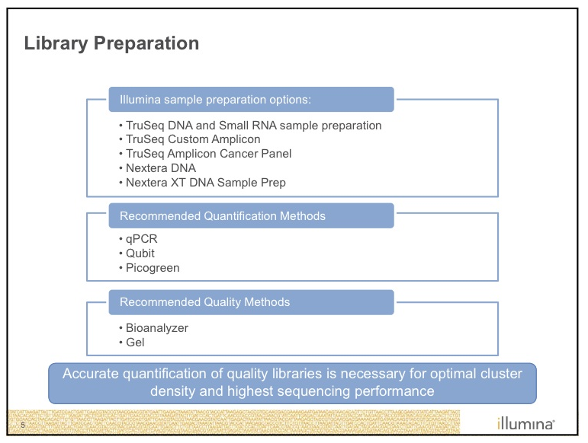
Notes:
NEB has similar sample prep kits so compare before buying. NEB will often give a significant discount if being used for a class so talk to customer support about this.

Slide 5
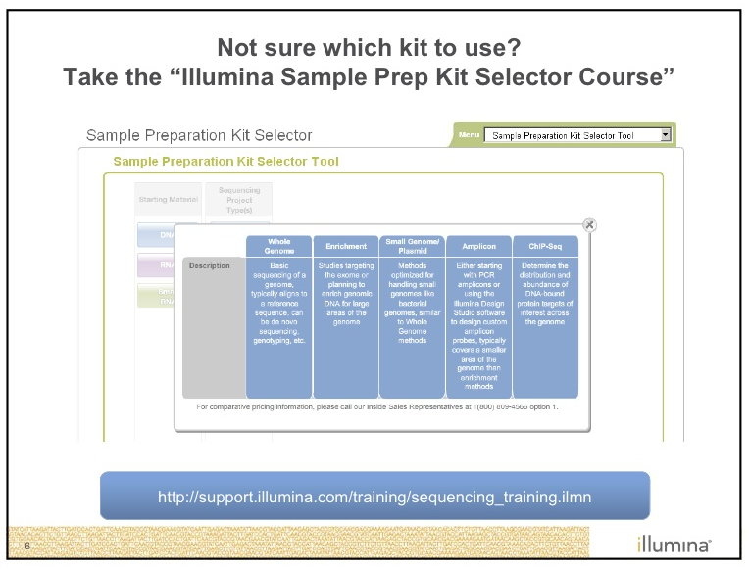
Notes:
This is just one of the many training courses on Illumina.com. Go to on projected laptop to show. Highlight Chemistry overview which is what this ppt mostly covers.

Slide 6
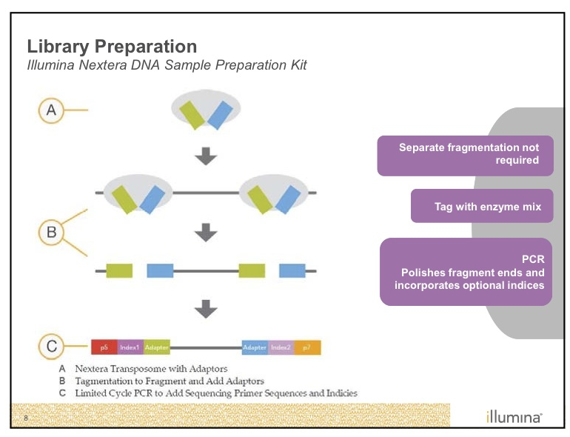
Notes:
Control size with the transposome to sample ratio as well as with AmpPure bead ratios. For RNA, adaptors and sequencing primers are added in the cDNA synthesis by ligating onto AT overhangs, then index and grafting primers added through the limited cycle PCR.

Slide 7
Total RNA isolation
End Repair of double-stranded cDNA
mRNA Isolation using Oligo(dT)
Magnetic Beads
Adenylation (A-Tailing)
A
AAAAAAA
A
TTTTTTTTT
TTTTTTTTT
AAAAAAA
AAAAAAAAAAAA
AAAAAAAAA
Blunt/TA Adaptor Ligation
T
U
TTTTTTTTT
TTTTTTTTTT
AAAAAAA
TTTTTTTTT
TTTTTTTTT
T
A
TTTTTTTT
AAAAAAA
U
AAAAAAAA
U
A
T
USER enzyme Excision
First-Strand cDNA Synthesis with Random Primers
PCR Amplification using a Universal
primer and index primer
AAAAAAAAAAAAA
NNNNNN
NNNNNN
NNNNNN
Second-Strand cDNA Synthesis
AAAAAAAAAAAAA
Double-Stranded cDNA
Barcode
Purify the double stranded cDNA with AMPure magnetic Beads
(1.8X ratio Beads to cDNA volume)
Purify and size select cDNA Library using AMPure Beads

Slide 8
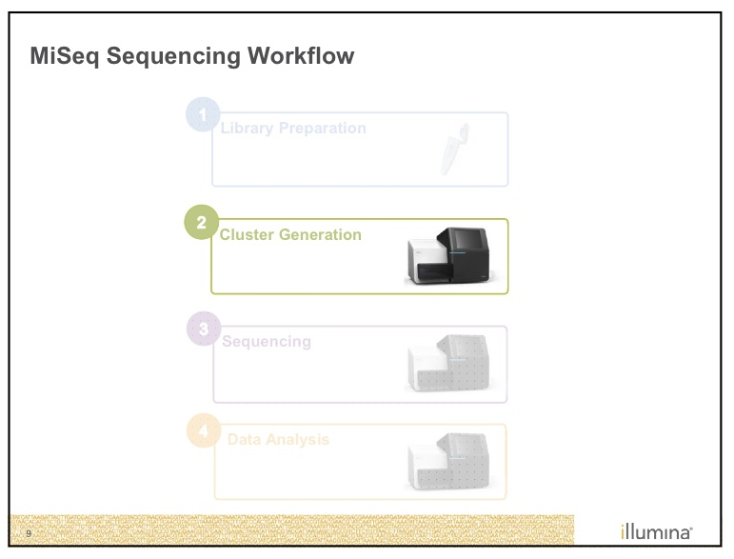

Slide 9
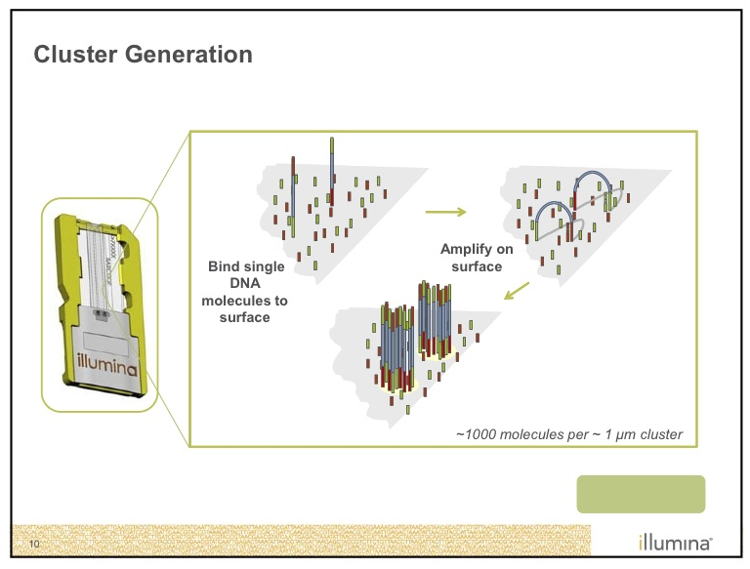

Slide 10
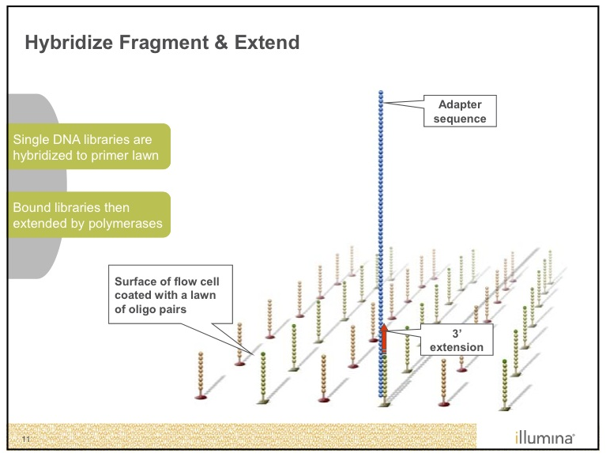

Slide 11
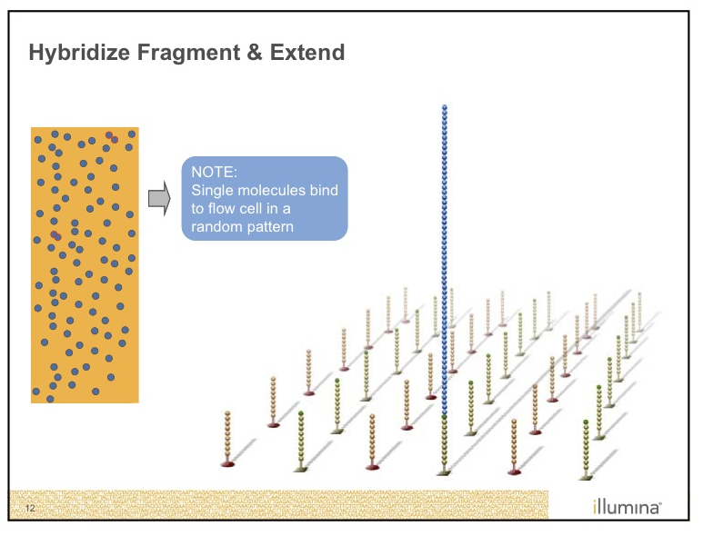

Slide 12
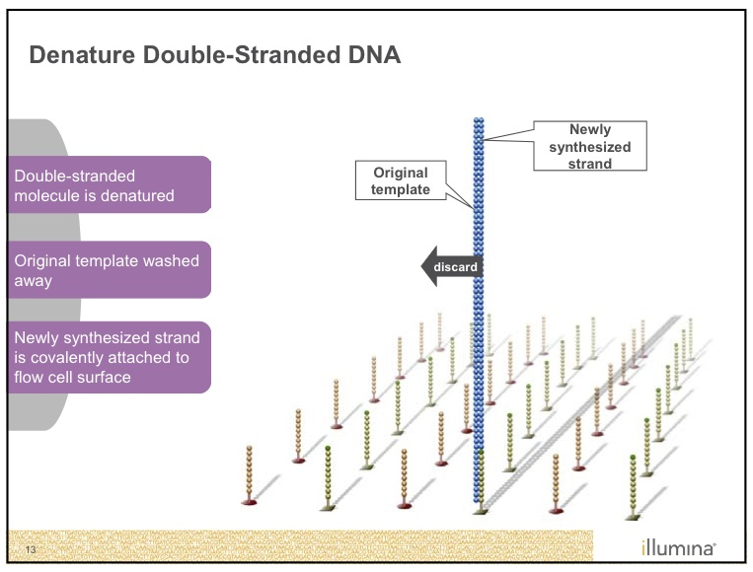

Slide 13
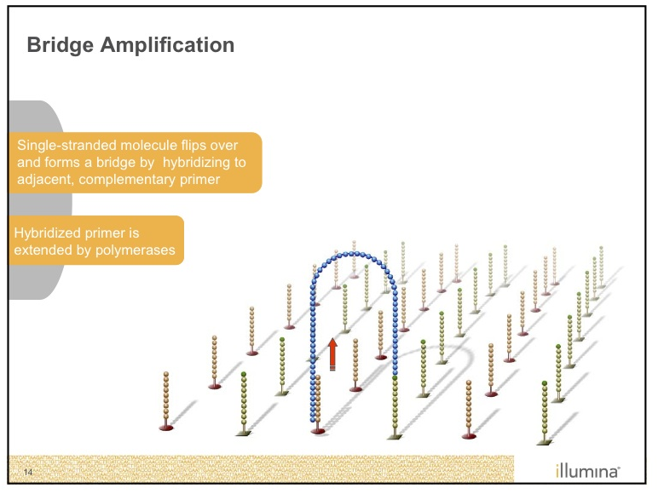

Slide 14
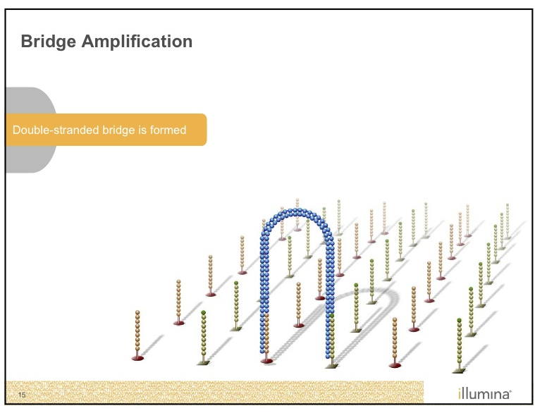

Slide 15
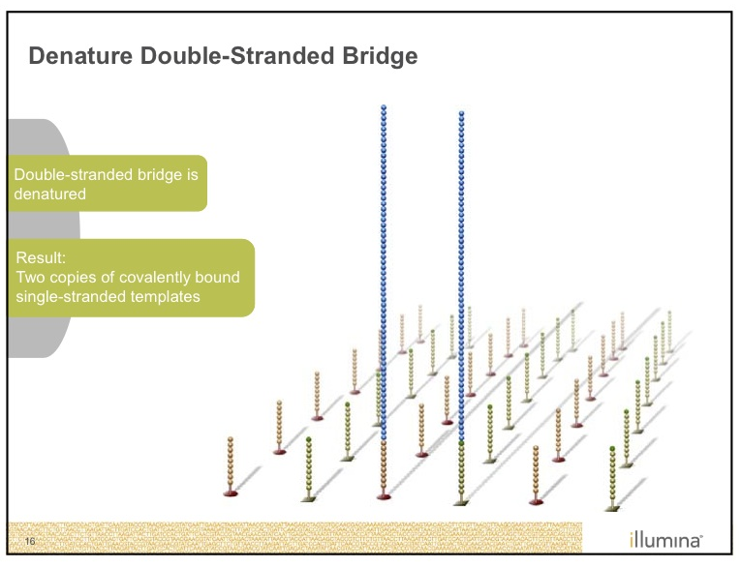

Slide 16
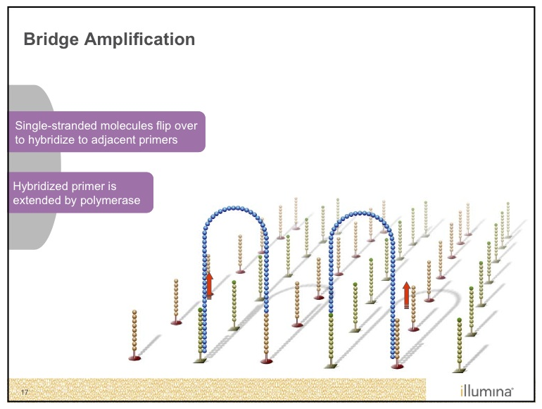

Slide 17
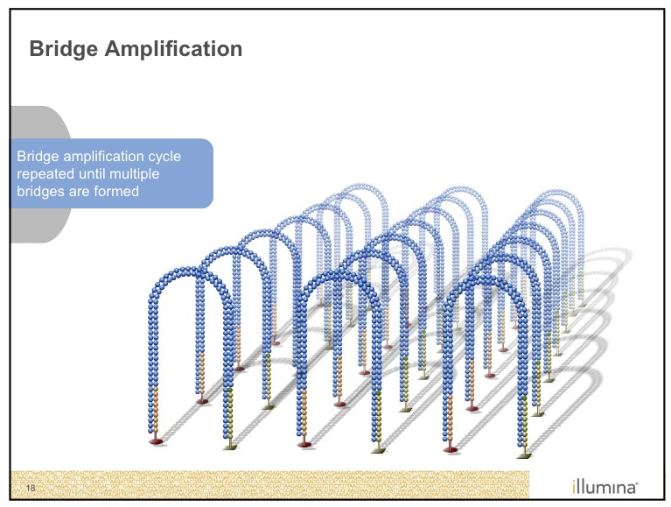

Slide 18
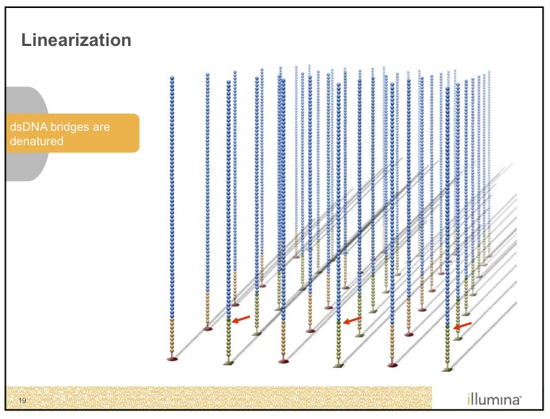

Slide 19
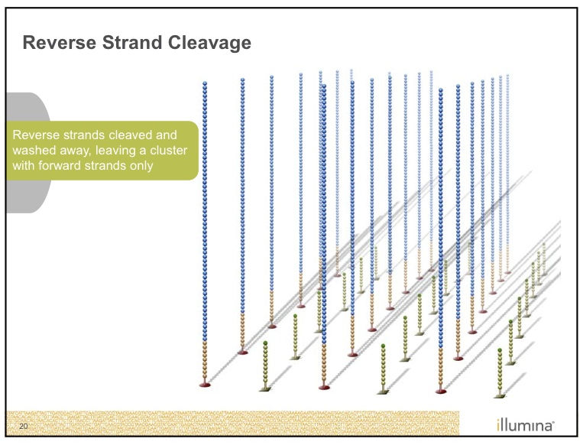

Slide 20
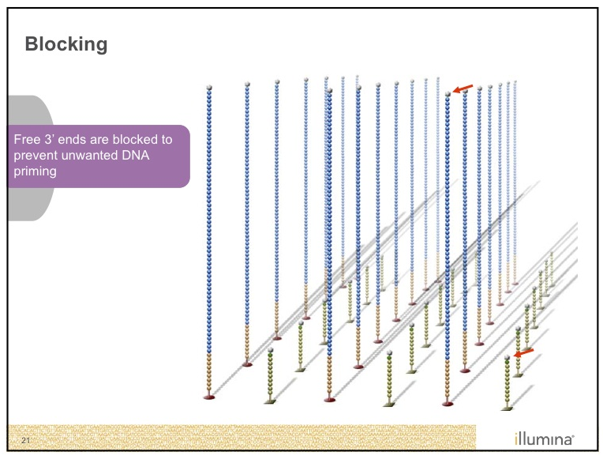

Slide 21
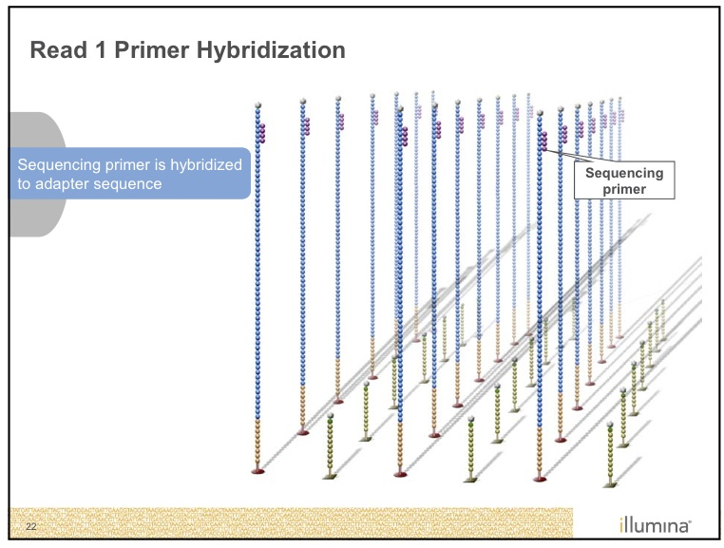

Slide 22
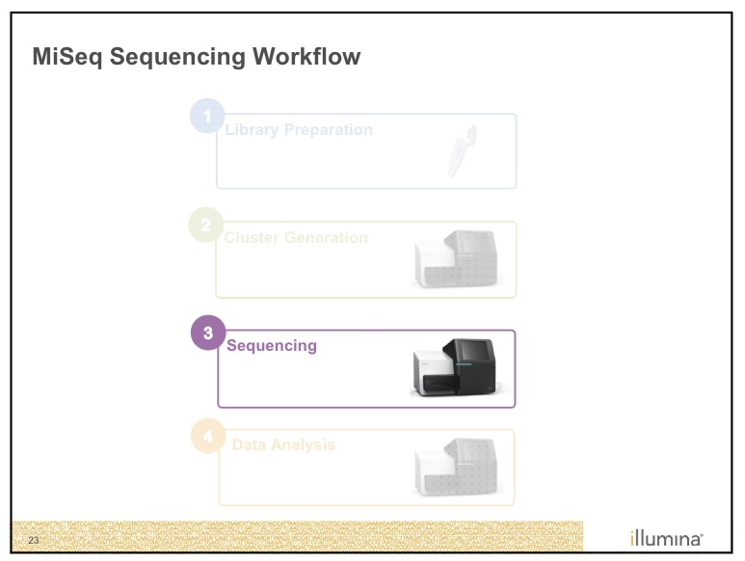

Slide 23
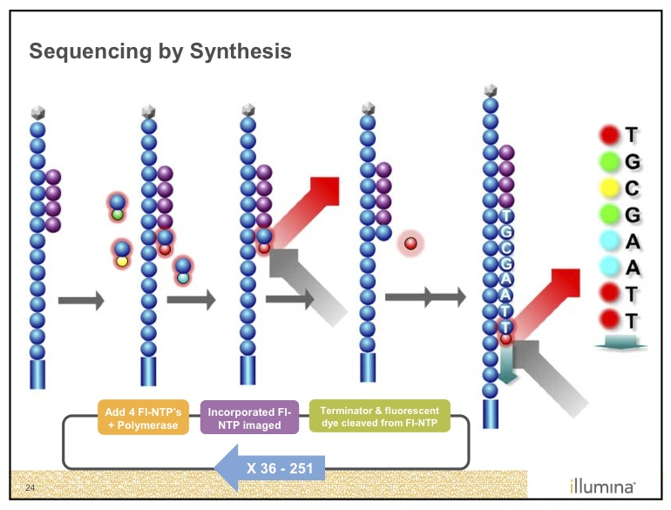

Slide 24
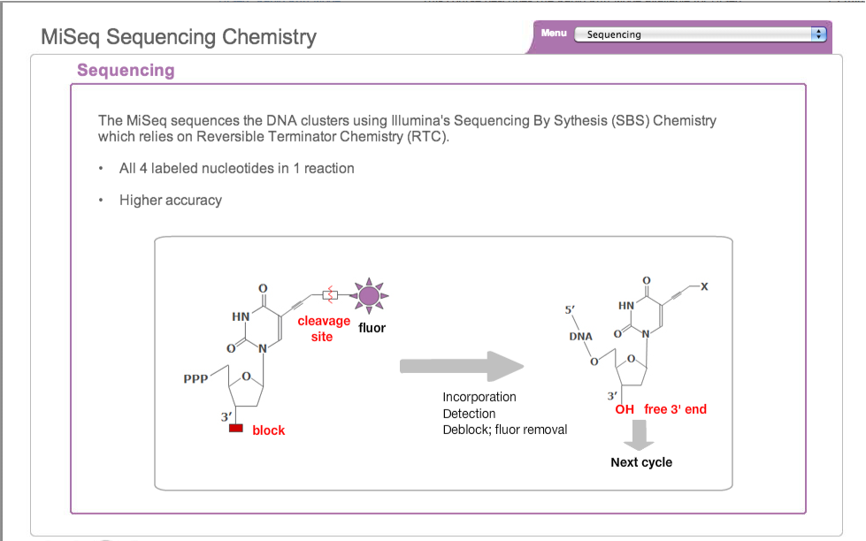

Slide 25
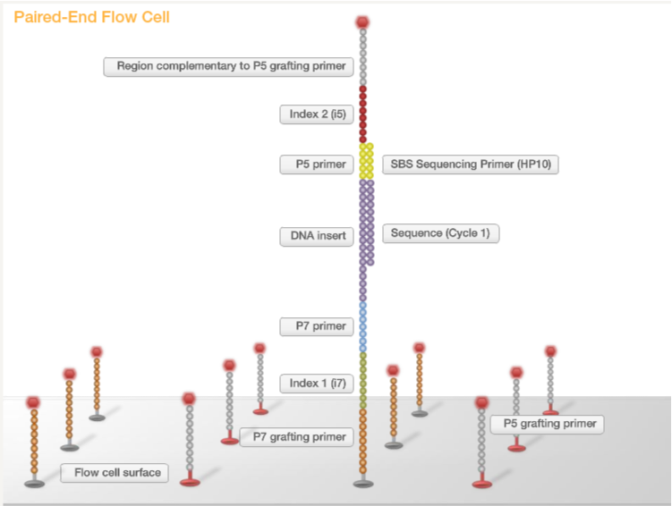

Slide 26
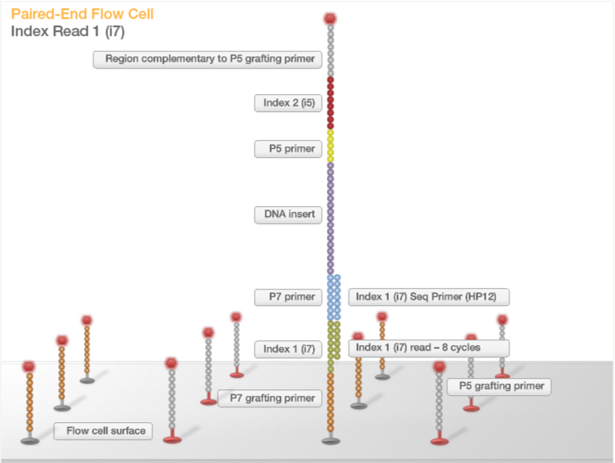

Slide 27
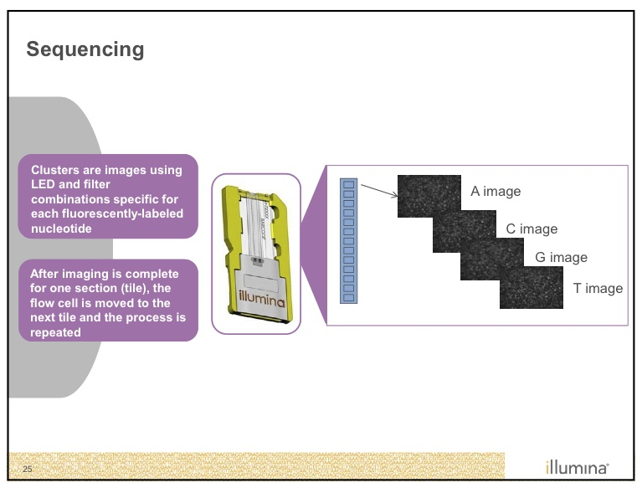

Slide 28
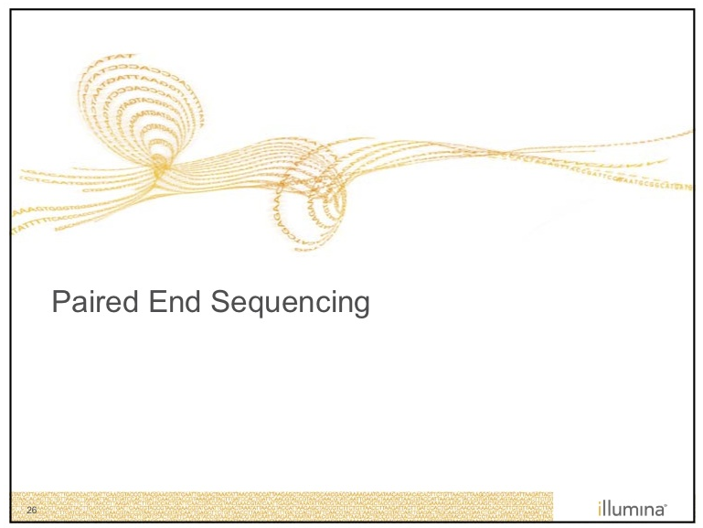

Slide 29
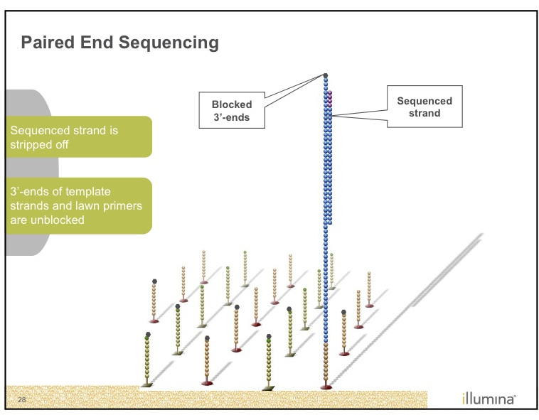

Slide 30
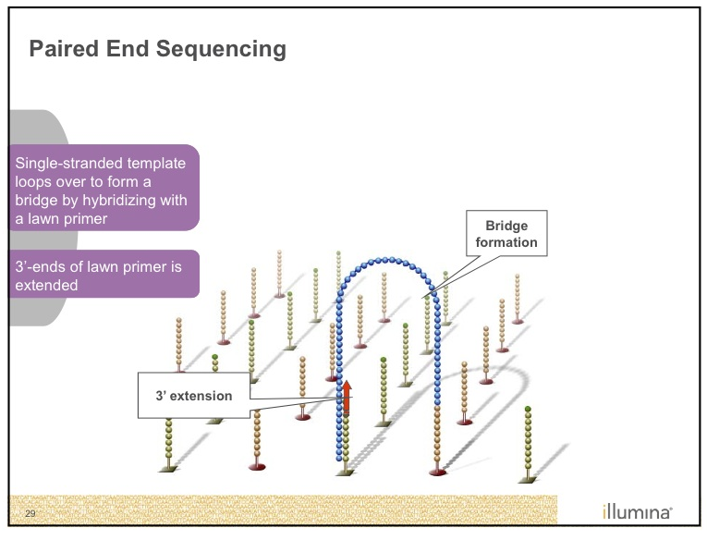

Slide 31
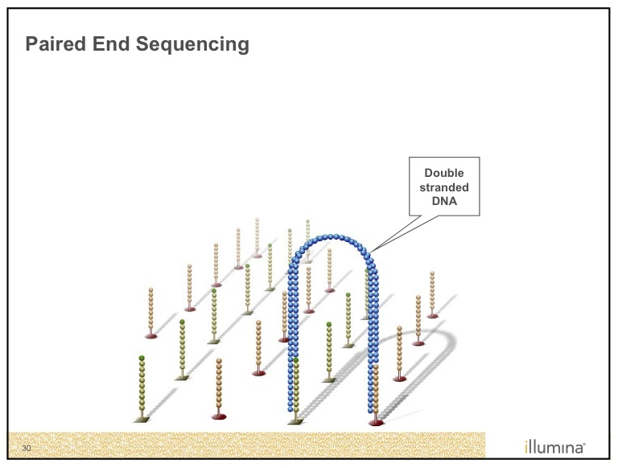

Slide 32
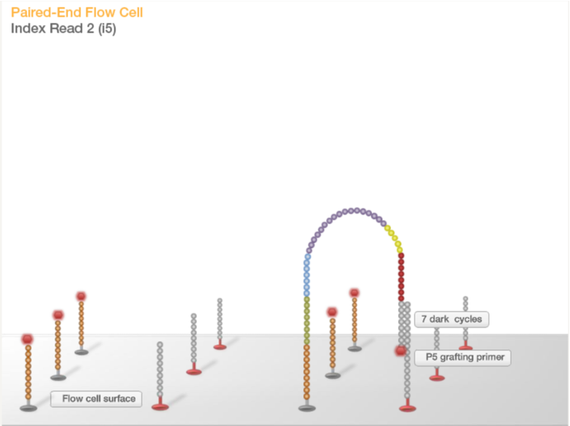

Slide 33
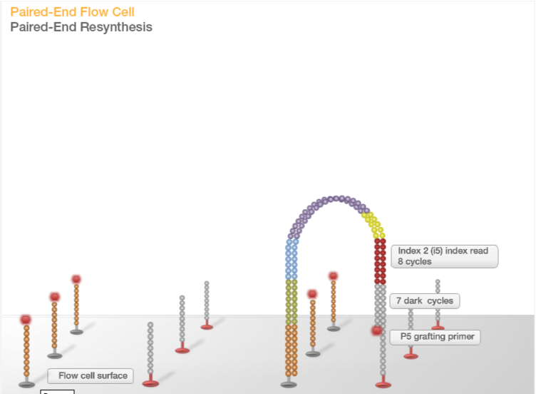

Slide 34
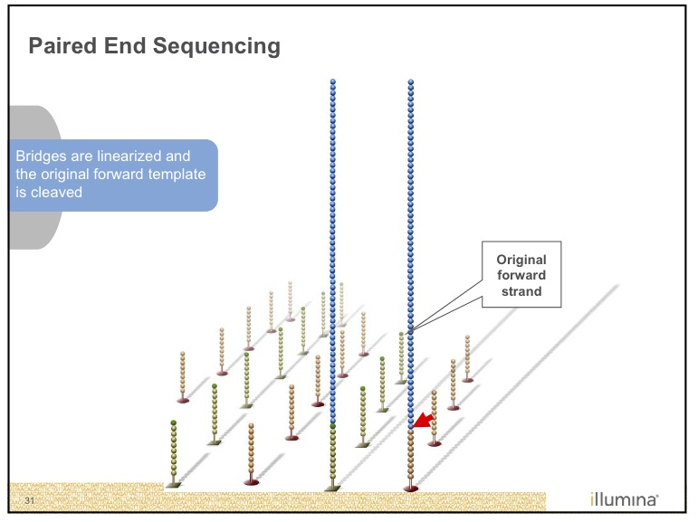

Slide 35
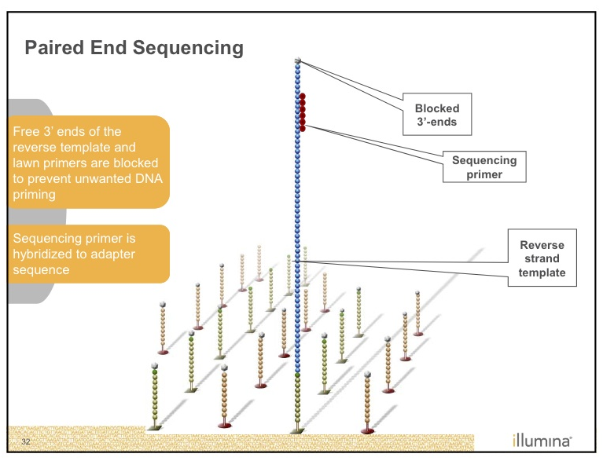

Slide 36
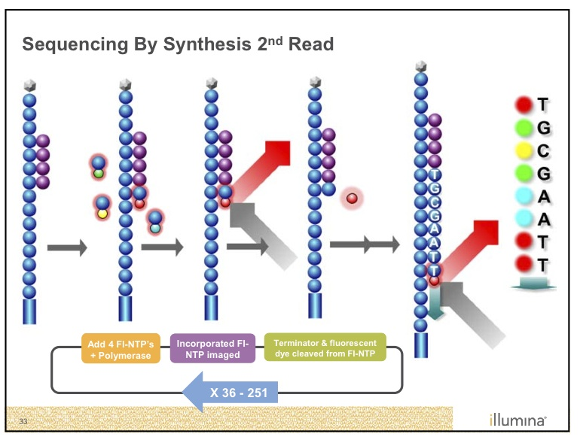

Slide 37
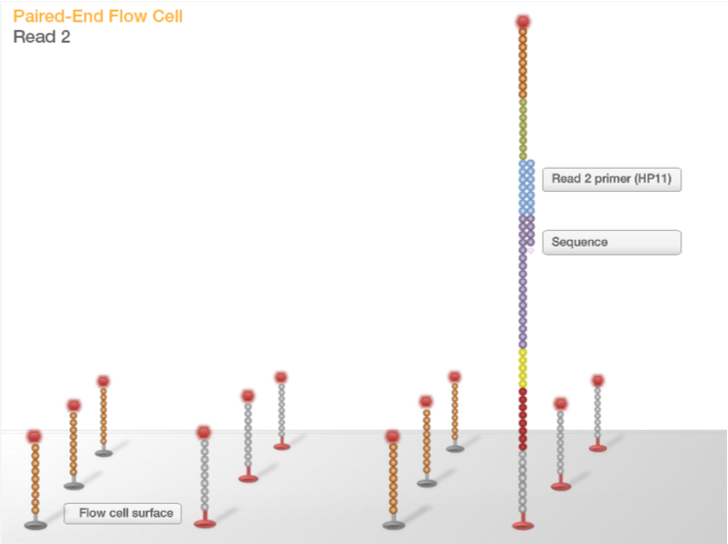

Slide 38
Experimental Workflow
Calculate coverage possible for your genome/transcriptome.
From there, decide how many samples will fit on your run.
Isolate your nucleic acid as usual and quantitate on Qubit (may want to isolate a couple of extra and take the best ones). RNA get rid of rRNA if not needed.
Prepare each library (for metagenomics, the isolating and library prep are combined by doing PCR with custom primers that have the grafting primer, indices, and sequencing primers built in).
Quantitate one more time if necessary then pool portions of libraries.
On day of sequencing you will denature and dilute your library and the PhiX library purchased from Illumina and pool together with PhiX being 1-5% of pool.

Slide 39
MiSeq Output Calculations
 | MiSeq with: - Upgraded hardware, or from September 2012 and later - MCS v2.0 or later - MiSeq Reagent Kit v2 | Older MiSeq run configurations.
Reads/flow cell | 16,000,000 | 5,000,000
Genome or region size (in bases) | Enter your value here | Enter your value here
Coverage | Enter your value here | Enter your value here
Total number of cycles (e.g. 300 for 2x150) | Enter your value here | Enter your value here
Total output required (in bases) | #VALUE! | #VALUE!
Output/flow cell (bases/flow cell) | #VALUE! | #VALUE!
Number of flow cells | #VALUE! | #VALUE!
The numbers in this spreadsheet are reasonable expectations assuming flow cells are clustered at the proper density. Output may vary based on sample quality, cluster density and other experimental factors. Use these calculations as estimates for planning your runs.
For more information about calculating coverage estimates, see the Coverage Calculation Tech Note.
http://support.illumina.com/sequencing/downloads.ilmn
Notes:
-16 million reads is considering paired end reads as 2. For RNA seq, think in terms that it can sequence about 7.5 million strands (literature seems to indicate ideal around 5 million reads for bacteria but 1 million sufficient for most applications with only a loss of the rarest transcripts which can be lost anyway in the background of excess coverage).
-For RNA seq, if don’t know transcriptome size, transcriptome generally 1-5% the size of a genome.
Generally accepted coverage is 30X but can be as high as 100X depending general acceptance of particular organism or goal (variant or SNP calling may require more) for an organism.

Slide 40
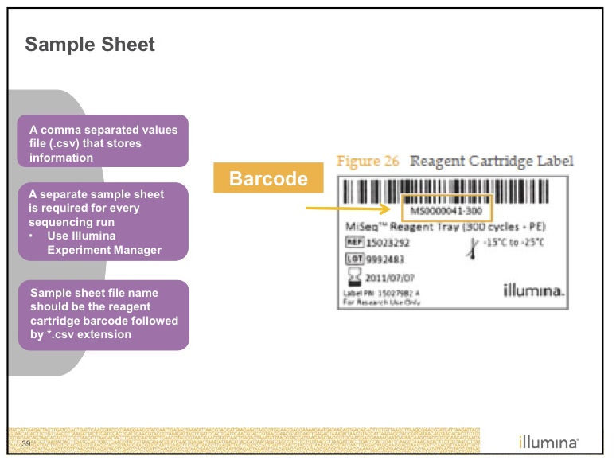

Slide 41
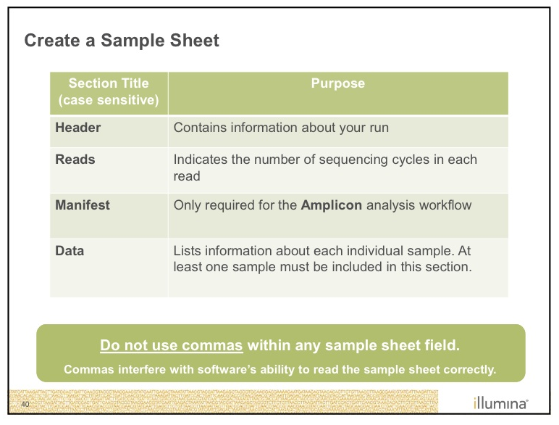

Slide 42
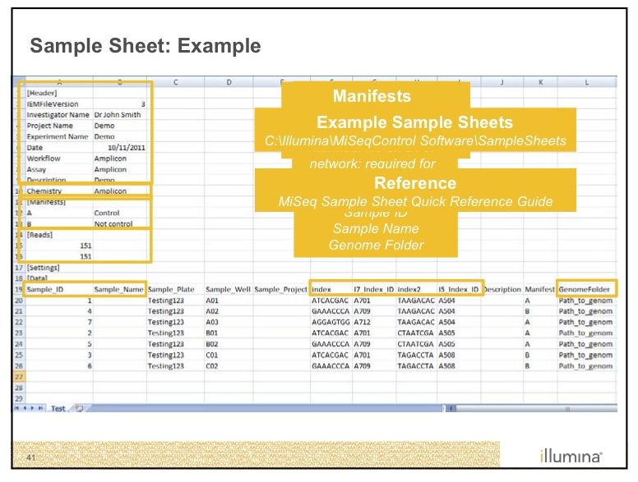

Slide 43
http://support.illumina.com/documents/documentation/System_Documentation/MiSeq/MiSeqSystem_UserGuide_15027617_H.pdf
http://support.illumina.com/documents/documentation/System_Documentation/MiSeq/MiSeq_PreparingDNAforMiSeq_15039740_B.pdf
Required Consumables
The following consumables are required to prepare DNA libraries for sequencing on the MiSeq:
HT1 (Hybridization Buffer), thawed and pre-chilled Illumina-supplied
Provided in the MiSeq reagent kit
Illumina PhiX Control, Catalog # FC-110-3001 Illumina-supplied (Optional)
Stock 1.0 N NaOH User-supplied
Tris-Cl 10 mM, pH 8.5 with 0.1% Tween 20 User-supplied
Prepare a Fresh Dilution of NaOH
CAUTION Using freshly diluted NaOH is essential in order to completely denature samples for cluster generation.
1 Prepare 1 ml of 0.2 N NaOH by combining the following volumes in a microcentrifuge tube:
• Laboratory-grade water (800 µl)
• Stock 1.0 N NaOH (200 µl)
2 Invert the tube several times to mix.
Denature and Dilute DNA
It is important that the concentration of NaOH is equal to 0.2 N in the denaturation
solution and not more than 0.001 (1 mM) in the final solution after diluting with HT1.
Dilute Denatured DNA for 4 nM Library
1 Dilute the denatured DNA to the desired concentration using the following example:
Final Concentration 6 pM 8 pM 10 pM 12 pM 15 pM 20 pM
20 pM denatured DNA 180 µl 240 µl 300 µl 360 µl 450 µl 600 µl
Pre-chilled HT1 420 µl 360 µl 300 µl 240 µl 150 µl 0 µl
Prepare PhiX Control
Notes:
Make sure to do the math and shoot for 7.5 million fragments total.

Slide 44
Combine Sample Library and PhiX Control
Illumina recommends a low-concentration PhiX control spike-in at 1% for most libraries.
For low diversity libraries, increase the PhiX control spike-in to at least 5%.
Combine the following volumes of denatured PhiX control library and your denatured sample library.
Most Libraries (1%) Low Diversity Libraries (≥ 5%)
Denatured and dilutedPhiX control 6 µl 30 µl
Denatured and diluted sample library 594 µl 570 µl
Set the combined sample library and PhiX control aside on ice until you are ready to load it onto the MiSeq reagent cartridge.

Slide 45
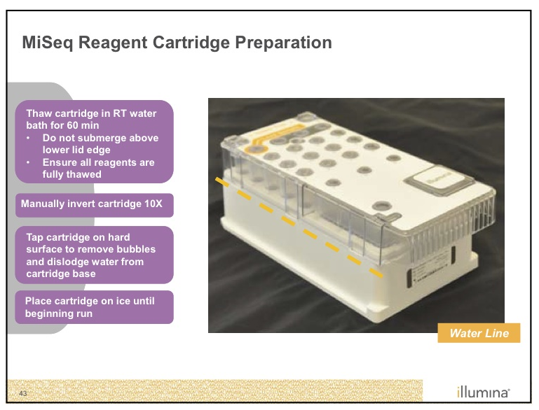

Slide 46
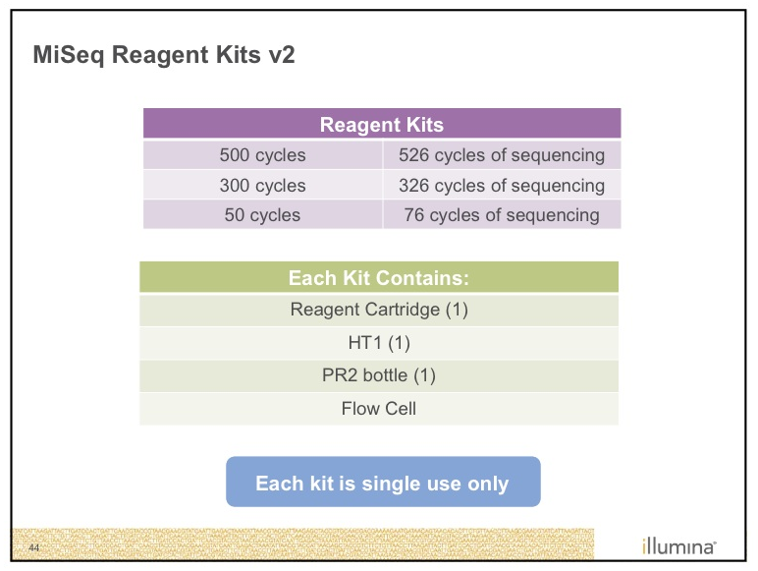

Slide 47
Catalog Id Name My Price (USD)
MS-102-1003 20 pack - MiSeq Reagent Kit (300-cycles - PE) 18340
MS-102-1005 20 pack - MiSeq Reagent Kit 50-cycles - PE) 13200
MS-102-1001 MiSeq Reagent Kit (300-cycles - PE) 965
MS-102-1002 MiSeq Reagent Kit (50-cycles - PE) 695
MS-102-2002 MiSeq Reagent Kit v2 (300 cycle) 930
MS-102-2022 MiSeq Reagent Kit v2 (300 cycle) - 20 pack 17680
MS-102-2001 MiSeq Reagent Kit v2 (50 cycle) 725
MS-102-2021 MiSeq Reagent Kit v2 (50 cycle) - 20 pack 13730
MS-102-2003 MiSeq Reagent Kit v2 (500cycle) 1035
MS-102-2023 MiSeq Reagent Kit v2 (500cycle) - 20 pack 19655
MS-103-1002 MiSeq Reagent Micro Kit, v2 (300 cycles) 775
FC-140-1001 Nextera Rapid Capture Exome (24 Samples) 4776
FC-140-1002 Nextera Rapid Capture Exome (48 Samples) 7152
FC-140-1003 Nextera Rapid Capture Exome (96 Samples) 9600
FC-140-1004 Nextera Rapid Capture Expanded Exome (24 Samples) 5376
FC-140-1005 Nextera Rapid Capture Expanded Exome (48 Samples) 8352
FC-140-1006 Nextera Rapid Capture Expanded Exome (96 Samples) 12000
FC-121-1030 Nextera¬Æ DNA Sample Preparation Kit (24 Samples) 1950
FC-121-1031 Nextera¬Æ DNA Sample Preparation Kit (96 Samples) 7000
FC-121-1204 Nextera¬Æ Exome Enrichment Kit 48 Samples 5952
FC-121-1208 Nextera¬Æ Exome Enrichment Kit 96 Samples 11904
FC-121-1011 Nextera¬Æ Index Kit (24 Indices, 96 Samples) 250
FC-121-1012 Nextera¬Æ Index Kit (96 Indices, 384 Samples) 950
RSBC10948 RNA-Seq Barcode Primers (Illumina-compatible) 48 Rxns 220
FC-132-1001 Nextera¬Æ Mate Pair Sample Prep Kit 4000
FC-131-1024 Nextera¬Æ XT DNA Sample Preparation Kit (24 Samples) 775
FC-131-1096 Nextera¬Æ XT DNA Sample Preparation Kit (96 Samples) 2900
FC-131-1001 Nextera¬Æ XT Index Kit (24 Indices, 96 Samples) 250
FC-131-1002 Nextera¬Æ XT Index Kit (96 Indices, 384 Samples) 950
FC-110-3001 PhiX Control Kit v3 150
NEB
ChIP-Seq Library Prep Master Mix for Illumina 12rxns $285, 60rxns $1140
NEBNext DNA Library Prep Master Mix Set for Illumina 12rxns $350, 60rxns $1400
NEBNext Ultra DNA Library Prep Master Mix Set for Illumina 24rxns $695, 96rxns $2225
NEBNext mRNA Library Prep Master Mix Set for Illumina 12rxns $525, 60rxns $2100

Slide 48
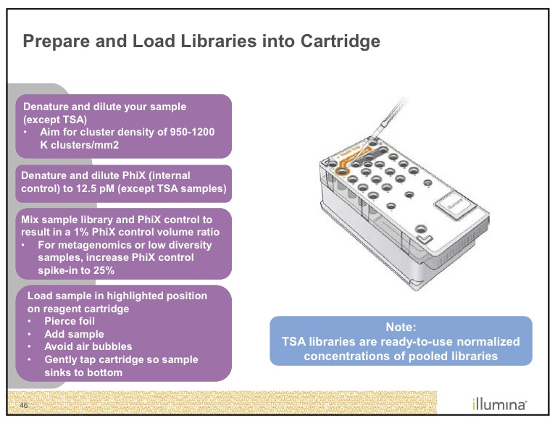

Slide 49
Using Custom Primers on the MiSeq
The MiSeq reagent cartridge contains 3 custom primer ports (position 18, 19, and 20) for use of custom primers on the MiSeq. Instructions for using primers in these ports, as well as primer dilution and sample sheet creation can be found in the Using Custom Primers on the MiSeq guide.
If PhiX is spiked into the sample library, the custom sequencing primers must be combined with the Illumina sequencing primers to ensure that the PhiX clusters are sequenced. Illumina’s sequencing primers are located in the following positions, which each contain 680µL of primer mix:
Position 12: Read 1 Primer Mix (HP10)
Position 13: Index Primer Mix (HP12)
Position 14: Read 2 Primer Mix (HP11)
Illumina recommends a final concentration of 0.5µM for the sequencing primers. Please note that competition for annealing exists when multiple sequencing primers are in the same mix, so this concentration may need to be further optimized. Also, custom sequencing primer design and quality are not verified by Illumina, therefore run quality for runs utilizing custom sequencing primers cannot be guaranteed.

Slide 50
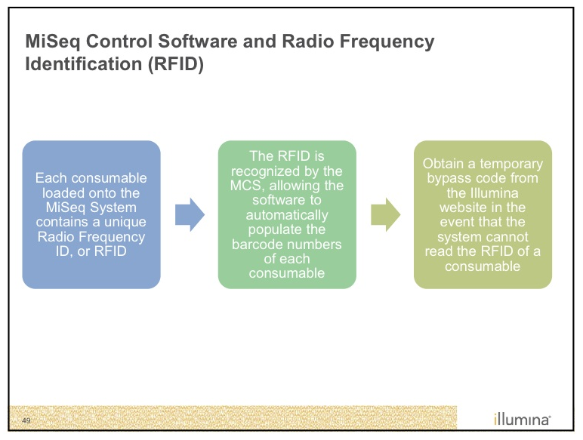

Slide 51
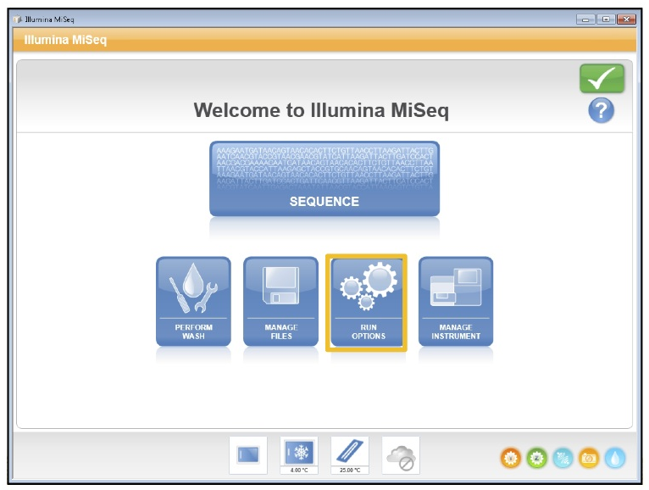

Slide 52
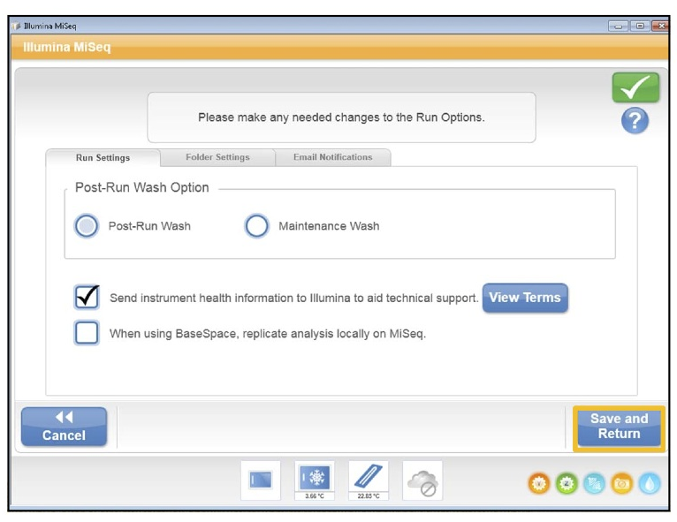

Slide 53
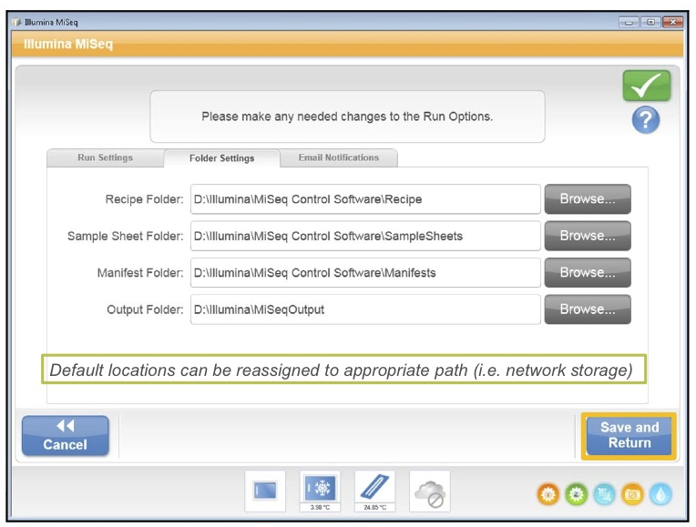

Slide 54
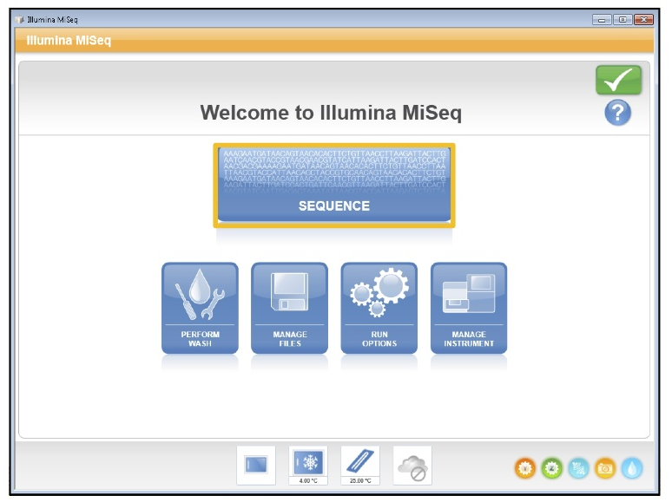

Slide 55
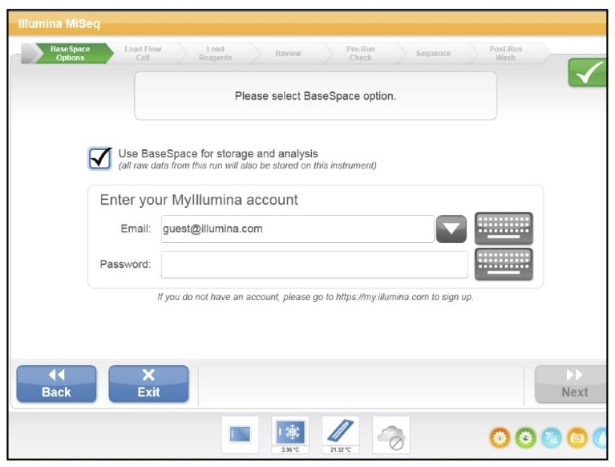

Slide 56
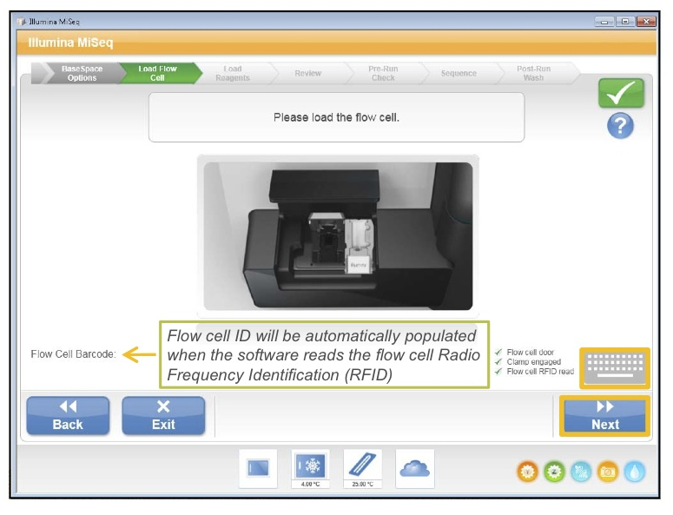

Slide 57
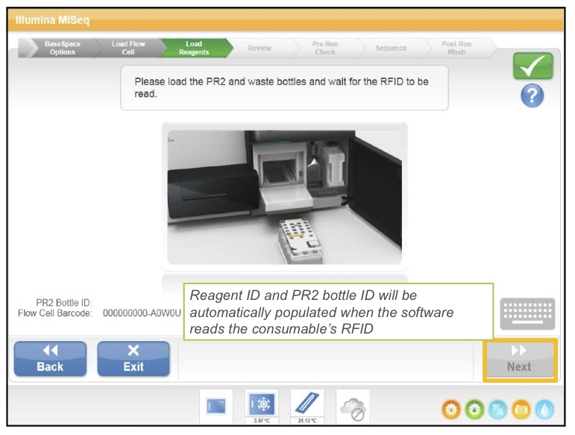

Slide 58
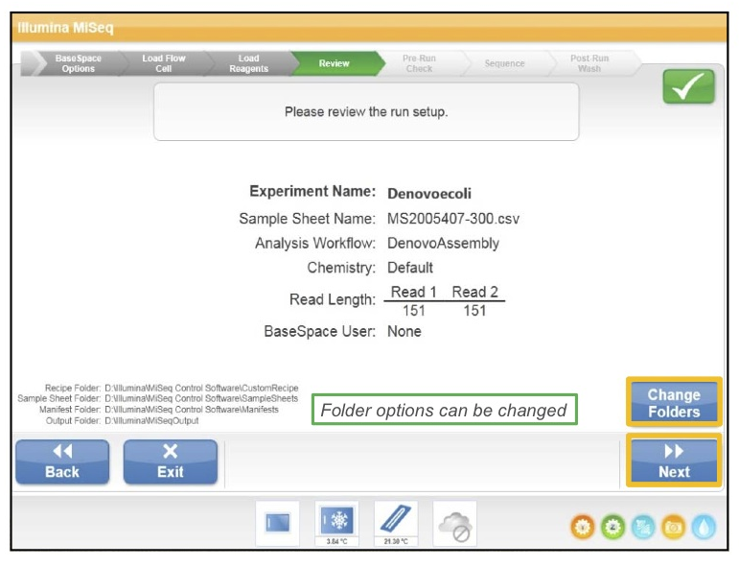

Slide 59


Slide 60


Slide 61


Slide 62


Slide 63


Slide 64


Slide 65


Slide 66


Slide 67


Slide 68
Bioinformatics on large datasets
Start by coming up with a workflow, then try to find a primary publication that did the same.
Sample workflows
Recommended Software = Galaxy - QC Data – may need to adapt to program (for Galaxy, use QC Groomer, then Fast QC).
- Trim Data (use Filter FastQ, and FastQ Trimmer in Galaxy)
- Assemble Data - referenced or de novo (after de novo once, use result for reference for future experiments)
For RNA-Seq
– Use Tophat to align your now clean reads to a reference genome and get accepted hits
-Use Cufflinks to combine the accepted hits into transcripts and assign gene names for count data and analysis (will also give a normalized read count per transcript – FPKM)
-Use CuffMerge to cummulate all data sets and then run CuffDiff for differential expression data.
-From there you will likely want to do Gene Ontology – DAVID and Cytoscape or other functional genomic resources depending on organism. SNP detection, variant calling.
For DNA
- I have used DNA Star right on the BaseSpace cloud to do de novo assembly of fastq files. I’m sure galaxy can be used as well. And there is always cammand line – Trinity in command line is supposed to be most preferred
For Metagenomics
Qiime which is command line is what seems to be what everybody uses, but it is basically an RNA Seq counting reads but needs to be aligned to multiple references.
When all else fails, Google “How to” or “Manual” or “Tutorial” your problem or get an account at SeqAnswers and ask the forum.
Notes:
Galaxy only works on small datasets, will not accept files bigger than 2GB so may have to split up and merge later. Will not do jobs over 2 days long. Files uploaded will be there for 60 days.
There is Illumina free software called MiSeq Reporter and CASAVA (command line) Tutorials for both and technical support on the phone. For all others, google how to(or tutorial) whatever your problem is. Can also google for manuals

Slide 69
References and Places to Go
-Watch some training videos that pertain to you at Illumina.com
http://support.illumina.com/training/sequencing_training.ilmn (Chemistry overview is wicked helpful).
-Register with Illumina.com to get your BaseSpace account and info on past and future webinars. Two Webinars coming up:
-Intro to Key Concepts in Illumina Seq Data Analysis July 11 at 1pm PST
-Planning: Experiments for the MiSeq System: Sample Prep and Workflow
July 17 at 10am PST
Get started on Galaxy here https://main.g2.bx.psu.edu/ Click on “user” and register.
There is also a Galaxy instance on a super computer at Indiana U called Mason – This may be quicker with different programs including Trinity (de novo assembler) which can otherwise only be used in command line. For a Mason account-if NSF funded use grant# and apply at NCGAS@indiana.edu If not NSF funded then join the GCAT consortium (only if doing GCAT work) and contact Mark Peterson at petersmp@juniata.edu to get you in. Otherwise, write a grant to XSEDE
Another bioinformatics tool you might like is -Unipro UGENE at http://ugene.unipro.ru/ It has a Tuxedo suite designed for RNAseq. Online manual and youtube podcasts.
Integrated Genome Browsers -UC Santa Cruz : hosts many genomes, including E.coli
-IGV at Broad Institute: recommended by Illumina
Gene Ontology -DAVID
-Cytoscape
-KEGG

Slide 70
Some Illumina Tech Notes to Peruse
An Introduction to Illumina NGS Technology for Microbiologists:
http://res.illumina.com/documents/products/sequencing_introduction_microbiology.pdf
High-Speed, Multiplexed 16S Microbial Sequencing on the MiSeq System:
http://res.illumina.com/documents/products/appnotes/appnote_miseq_16s.pdf
Estimating Sequencing coverage:
http://res.illumina.com/documents/products/technotes/technote_coverage_calculation.pdf
Understanding Illumina Quality Scores:
http://res.illumina.com/documents/products/technotes/technote_understanding_quality_scores.pdf
And many more at:
http://support.illumina.com/sequencing/literature.ilmn

